Slide 1
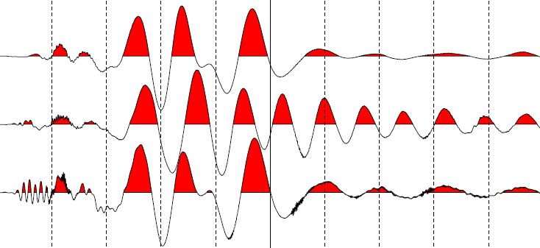
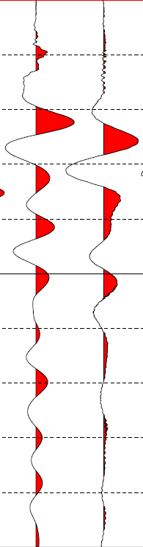
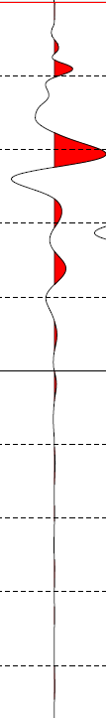
a.
b.
0 20 40 60 80 100 120 140 160 180
Time (milli-seconds)
Well plant
Wooden platform
Round platform
Drone
Satisfactory plant

